Slide 1


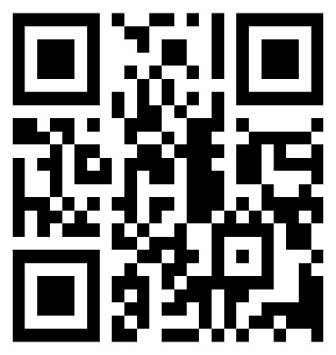
Admission to Master of Engineering Programmes
Goa College of Engineering, Farmagudi, Ponda
Applications for the admission to following Master of Engineering programmes for the Academic year 2024-25 are invited online by Principal, Goa College of Engineering, Farmagudi, Ponda, Goa.
    M.E. (Geotechnical Engg.)
    M. E. (Industrial Engg.)
    M.E. (Power & Energy Engg.)
    M.E. (Electronics Comm. & Instrumentation Engg.)
    M.E. (Industrial Automation & Robotics)
    M.E. (Structural Engg.)
    M.E. (Information Technology & Engg.)
    M.E. Computer Science & Engg. (Artificial Intelligence & Machine Learning)
The candidates shall pay application fee of Rs. 1200/- in online mode. The last date for submission of application is 26 Aug. 2024 at https://gecis.gec.ac.in
Dr. Krupashankara M.S.
Principal
QR Code

